Slide 1



Study Smarter with the Pomodoro Technique!
www.Studyreach.in
The Pomodoro Technique is a time management method that helps you: • Focus on tasks in short, timed intervals • Take regular breaks to stay fresh • Boost productivity without feeling overwhelmed
by Shailendra Porwal
Cont….

Slide 2
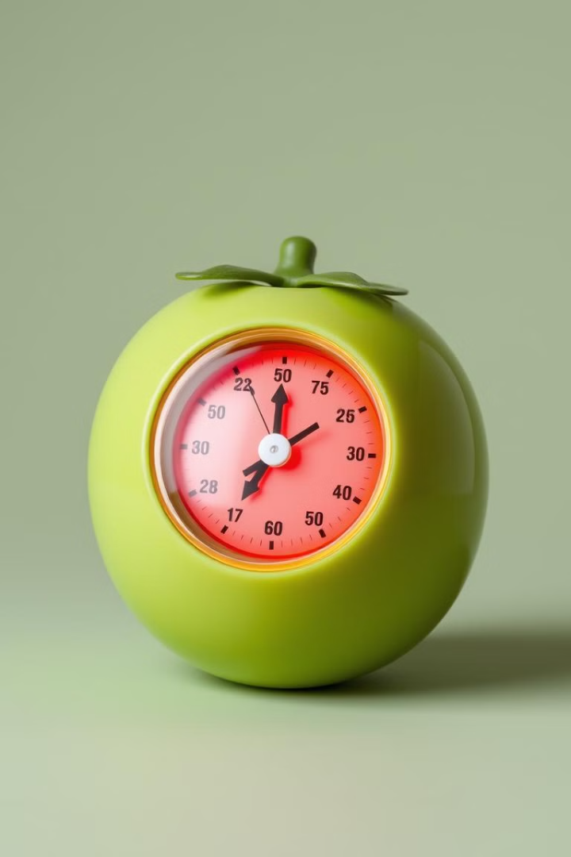
What is the Pomodoro Technique
www.Studyreach.in
Focus on tasks in short, timed intervals
The Pomodoro Technique is a time management method that helps you: • Focus on tasks in short, timed intervals • Take regular breaks to stay fresh • Boost productivity without feeling overwhelmed
Take regular breaks to stay fresh
The Pomodoro Technique is a time management method that helps you: • Focus on tasks in short, timed intervals • Take regular breaks to stay fresh • Boost productivity without feeling overwhelmed
Cont….

Slide 3
How It Works
www.Studyreach.in
1
Pick a task (e.g., studying for an exam, homework).
Pick a task (e.g., studying for an exam, homework). 2. Set a timer for 25 minutes. o This 25-minute work period is called a Pomodoro. 3. Work on the task until the timer goes off. 4. Take a 5-minute break. o Relax, stretch, or grab a snack!
2
Set a timer for 25 minutes.
Pick a task (e.g., studying for an exam, homework). 2. Set a timer for 25 minutes. o This 25-minute work period is called a Pomodoro. 3. Work on the task until the timer goes off. 4. Take a 5-minute break. o Relax, stretch, or grab a snack!
3
Work on the task until the timer goes off.
Pick a task (e.g., studying for an exam, homework). 2. Set a timer for 25 minutes. o This 25-minute work period is called a Pomodoro. 3. Work on the task until the timer goes off. 4. Take a 5-minute break. o Relax, stretch, or grab a snack!
4
Take a 5-minute break.
Pick a task (e.g., studying for an exam, homework). 2. Set a timer for 25 minutes. o This 25-minute work period is called a Pomodoro. 3. Work on the task until the timer goes off. 4. Take a 5-minute break. o Relax, stretch, or grab a snack!
Cont….

Slide 4

www.Studyreach.in
After Every 4 Pomodoros
1
After completing 4 Pomodoros (4 work intervals), take a longer break (15-30 minutes).
After completing 4 Pomodoros (4 work intervals), take a longer break (15-30 minutes). • This longer break helps you recharge before starting the next set of Pomodoros.
2
This longer break helps you recharge before starting the next set of Pomodoros.
After completing 4 Pomodoros (4 work intervals), take a longer break (15-30 minutes). • This longer break helps you recharge before starting the next set of Pomodoros.
Cont….

Slide 5
www.Studyreach.in
Why It Works
Improves focus:
Reduces burnout:
Better time management:
You work in short, intense bursts. • Reduces burnout: Breaks help keep your mind fresh. • Better time management: Helps you stay organized. • Motivates you: The timer creates urgency to complete the task.
You work in short, intense bursts. • Reduces burnout: Breaks help keep your mind fresh. • Better time management: Helps you stay organized. • Motivates you: The timer creates urgency to complete the task.
You work in short, intense bursts. • Reduces burnout: Breaks help keep your mind fresh. • Better time management: Helps you stay organized. • Motivates you: The timer creates urgency to complete the task.
Cont….

Slide 6




Tips for Success
www.Studyreach.in
Remove distractions during the Pomodoro (no phone or social media).
Remove distractions during the Pomodoro (no phone or social media). • Plan tasks ahead: Write down what you need to do. • Stick to the timer: Don’t skip breaks! • Start small: Try with just a few Pomodoros a day.
Plan tasks ahead: Write down what you need to do.
Remove distractions during the Pomodoro (no phone or social media). • Plan tasks ahead: Write down what you need to do. • Stick to the timer: Don’t skip breaks! • Start small: Try with just a few Pomodoros a day.
Stick to the timer: Don’t skip breaks!
Remove distractions during the Pomodoro (no phone or social media). • Plan tasks ahead: Write down what you need to do. • Stick to the timer: Don’t skip breaks! • Start small: Try with just a few Pomodoros a day.
Start small: Try with just a few Pomodoros a day.
Remove distractions during the Pomodoro (no phone or social media). • Plan tasks ahead: Write down what you need to do. • Stick to the timer: Don’t skip breaks! • Start small: Try with just a few Pomodoros a day.
Cont….

Slide 7
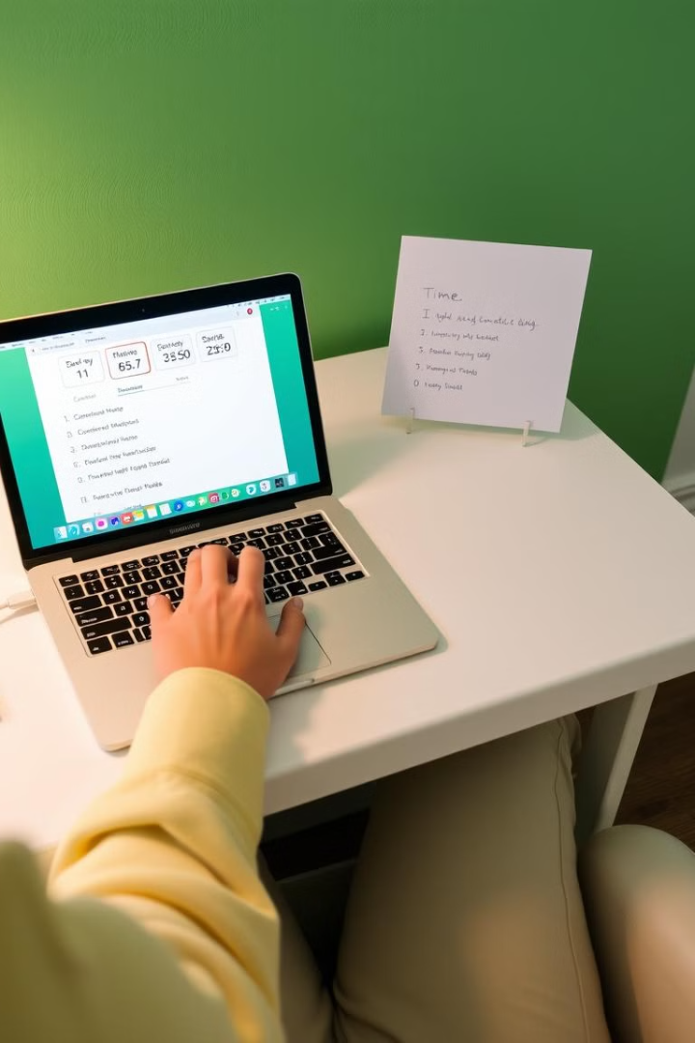
www.Studyreach.in
Example
25 minutes
Study Chapter 1
5 minutes
Break
25 minutes
Review notes
5 minutes
Break
Repeat until you've completed 4 Pomodoros, then take a longer break!
Thanks….

Slide 8


